Slide 1
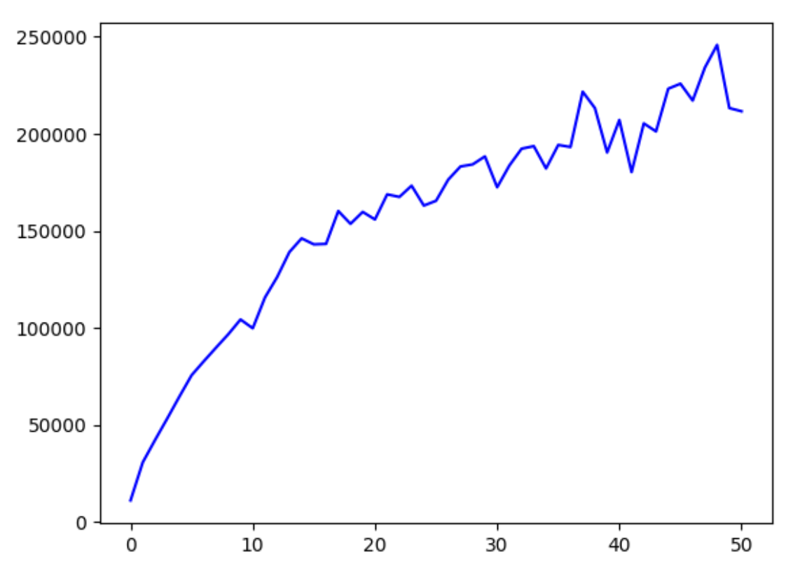
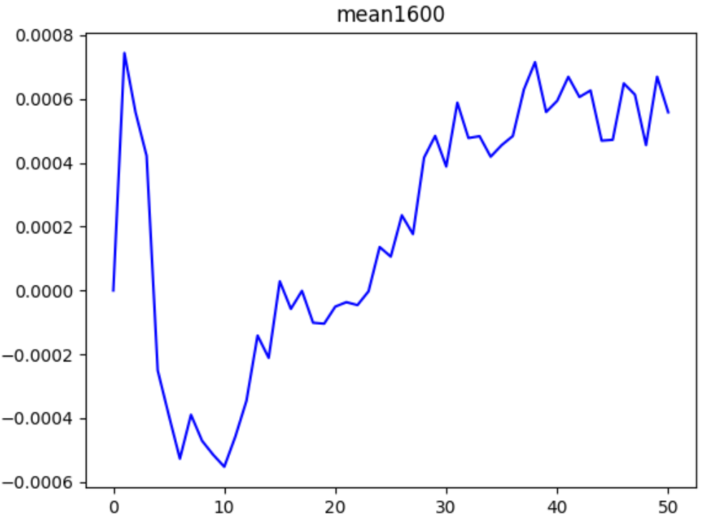
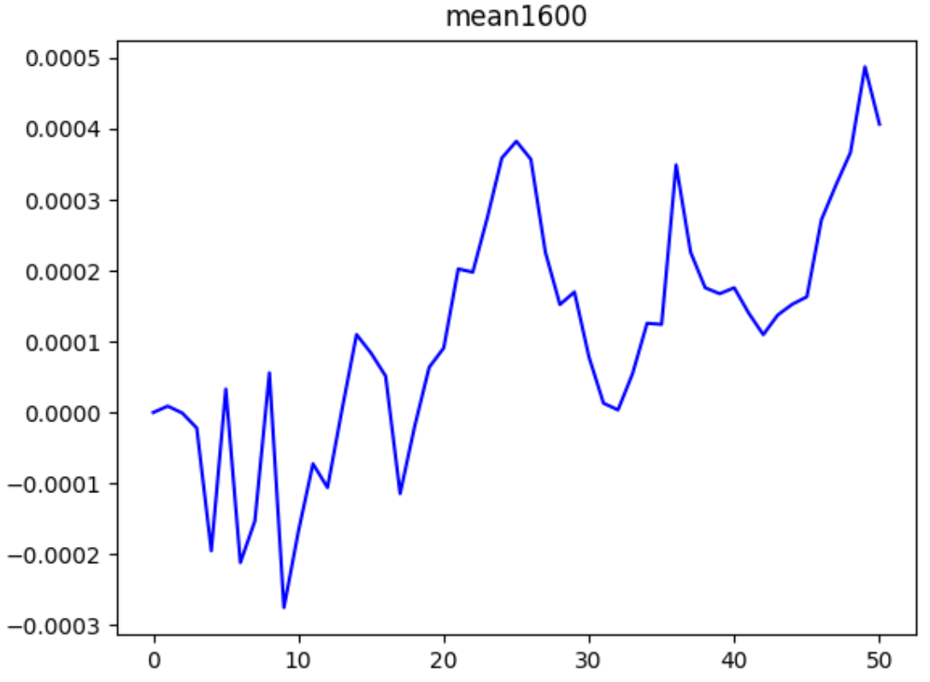
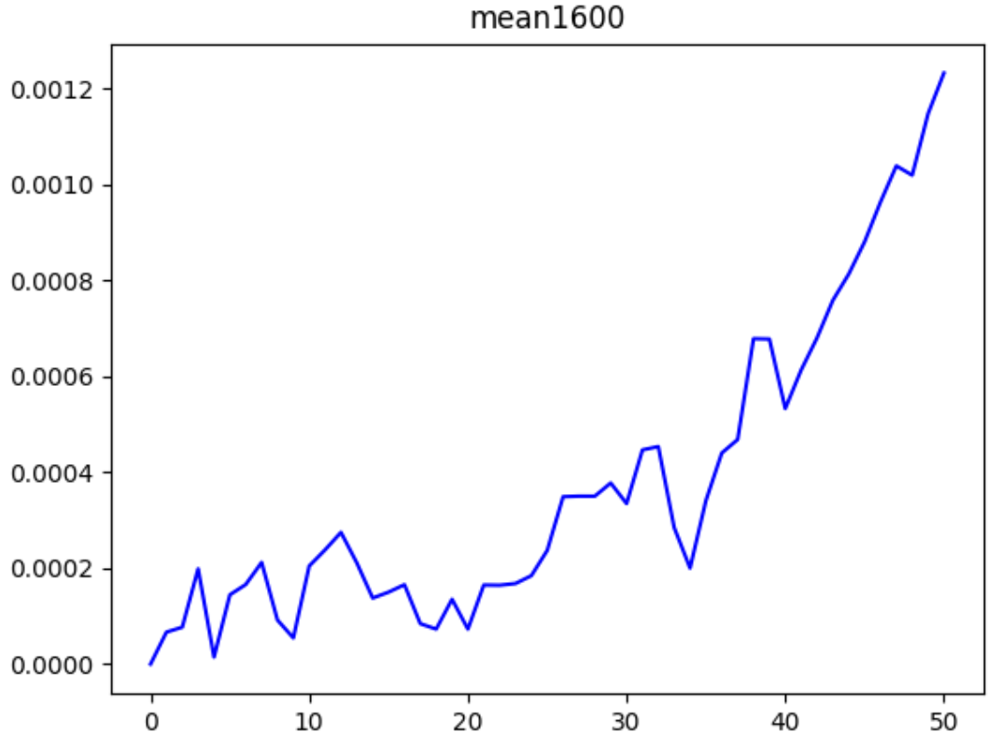
Why mean value fluctuate
numbers of degrees (❌)
time span with neighbors
0
1
5

Slide 2
Degree-Accuracy
degree | Test AP | Test AUC
small | 0.6946 | 0.6775
average | 0.8760 | 0.8695
large | 0.9376 | 0.9273
epoch=0
degree | Test AP | Test AUC
small | 0.7405 | 0.7325
average | 0.8832 | 0.8713
large | 0.9427 | 0.9328
epoch=1
small: extract the first 20 vertices with smallest degree
large: extract the last 20 vertices with largest degree
average: extract vertices with degree in [avg_degree-1, avg_degree+1]

Slide 3
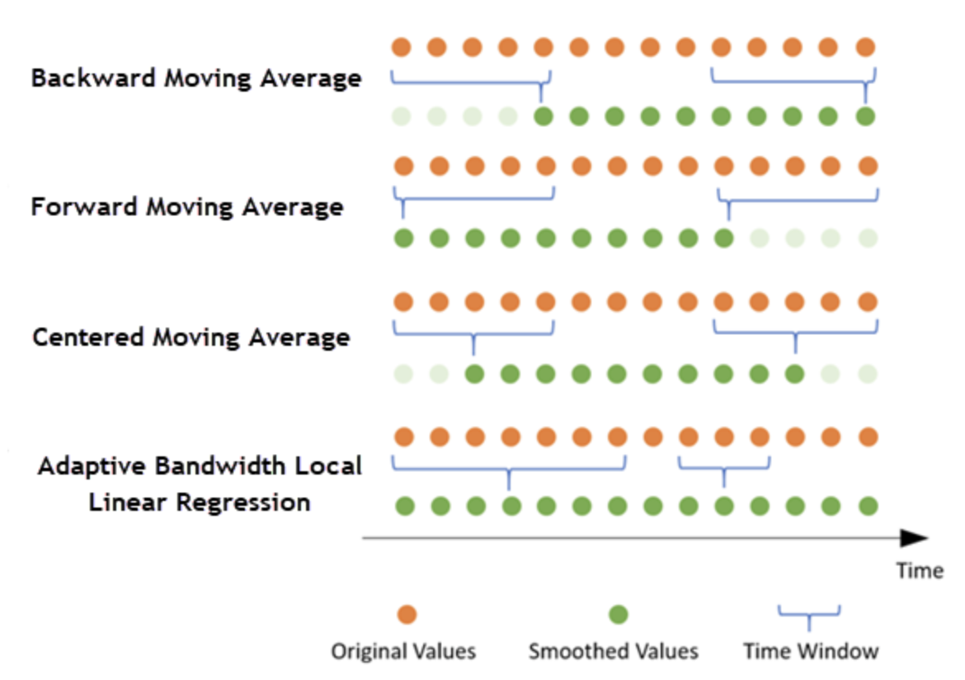
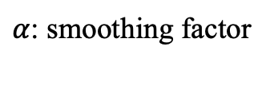
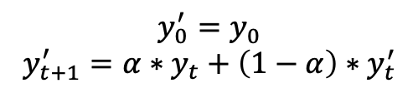
Time-series data smoothing
rolling mean
Exponential smoothing
$$y_{0}^{′}=y_{0}$$
$$y_{t+1}^{′}=α∗y_{t}+\left(1−α\right)∗y_{t}^{′}$$
$α$: smoothing factor

Slide 4
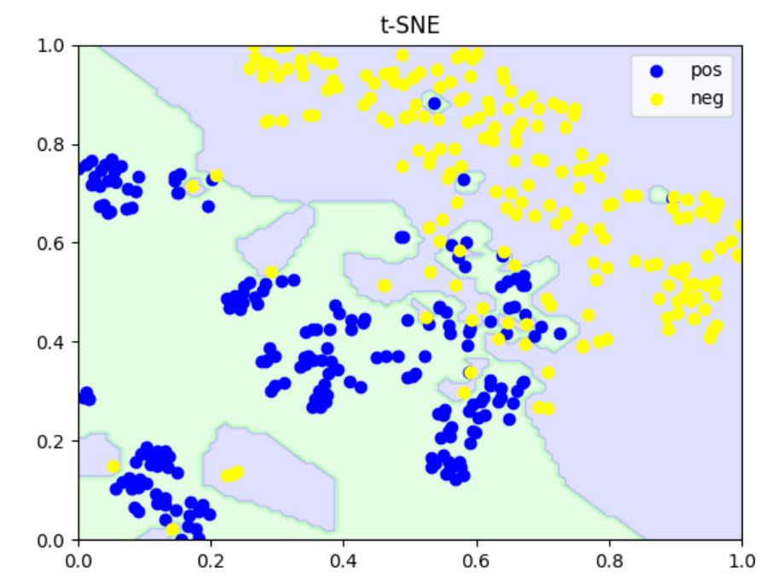
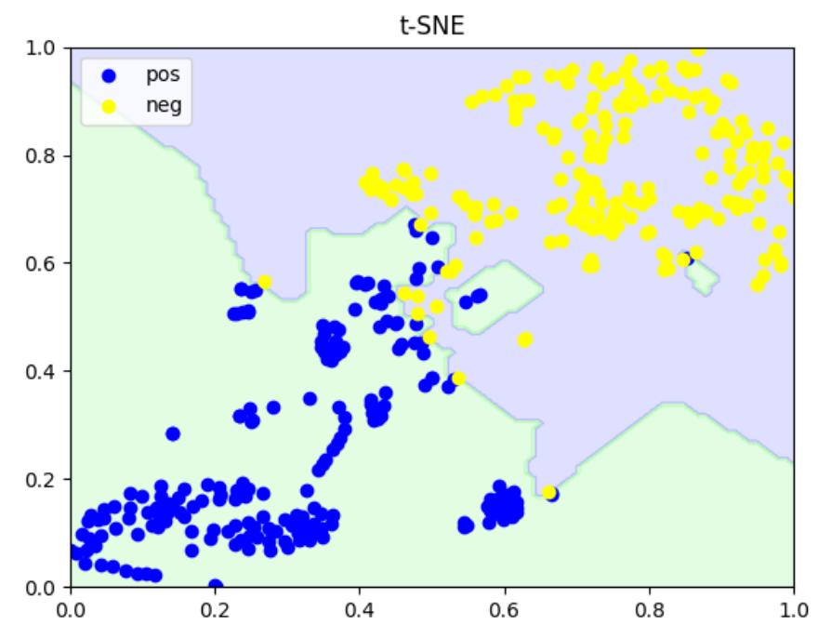
Decision boundary

